Slide 1


MEDICAL STORE MANAGEMENT
TEAM MEMBERS:- Ankit Gajera
Dhruv shah
Deep shah
PES Trainee, eiTRA
02/22/17

Slide 2
About This Project:-
The whole project is based on file handling as all medical records are stored in file.
Data structure have been used to store and organize records. Overall, understanding this project will provide you valuable information on how to store, edit, search and delete data using file.

Slide 3
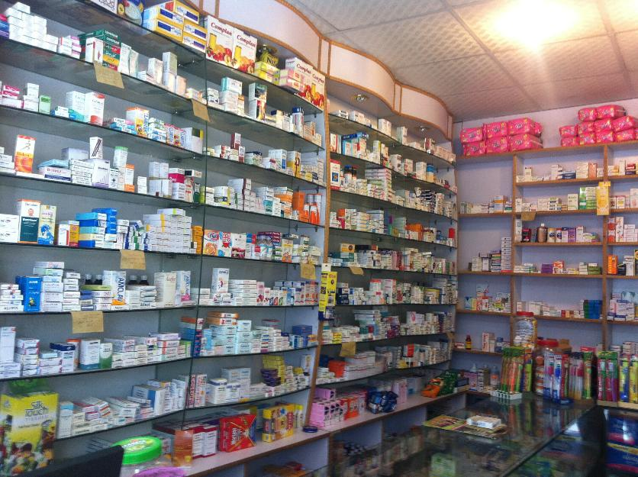
Medical Store:-

Slide 4
MODULES:-
Customer
Medicine
Bill
Report

Slide 5
Customer Module:-
Functionality:-
1)add_customer;-Add customer (in sell medicine)
2)update_customer
3)search_customer(search customer in bill file)

Slide 6
Medicine Module :-
Add medicine
Sell medicine
Update medicine
Delete medicine
Buy medicine

Slide 7
Bill and Report module:
Gnerate Bill
Show repot

Slide 8
Thank you

